Slide 1



Image-embodied Knowledge Representation Learning
汇报人：黄婷

Slide 2


目录
DIRECTORY
01
02
03
04
05
Introduction
Related Work
Methodology
Experiments
Conclusion and Future Work

Slide 3

01
Introduction

Slide 4
Introduction
We propose a novel IKRL model considering visual information in entity images for knowledge representation learning. To the best of our knowledge, this is the first attempt to combine images with knowledge graphs for knowledge representation learning.
We evaluate our models on a real-world dataset and receive promising performances on both knowledge graph completion and triple classification.
We further conduct detailed analysis on representative cases, which confirms the power of attention in selecting informative images. We also find some interesting semantic regularities between image representations.

Slide 5
02
Related Work

Slide 6
Related Work
Translation-based Methods
Multi-source Information Learning
TransE，TransH，TransR，TransD
textual information
entity descriptions
visual information

Slide 7
03
Methodology

Slide 8
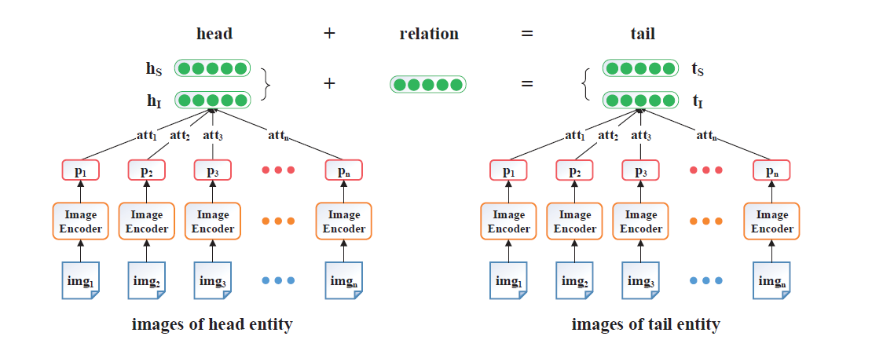
Methodology

Slide 9
Methodology
Overall Architecture
the structure-based representations (SBR) of head and tail
the image-based representations
(IBR) of head and tail

Slide 10

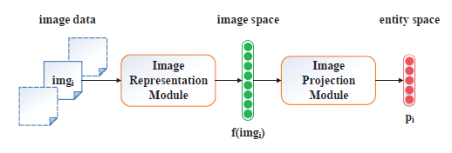
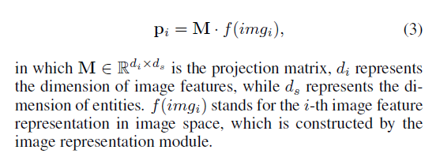
Methodology
Image Encoder
For each entity , there are multiple image instances
represented as:
1.Image Representation Module
2.Image Projection Module
We utilize AlexNet, a widely-used neural
network that contains five convolution layers, two fully connected layers and a softmax layer, to extract image features

Slide 11
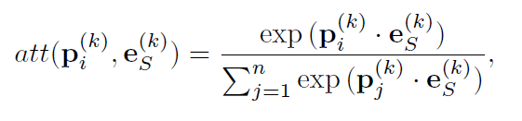
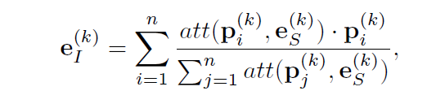
Methodology
Attention-based Multi-instance Leaning
For the i-th image representation of the k-th entity, the attention is defined as follows:
we define the aggregated imagebased representation for the k-th entity as follows:

Slide 12
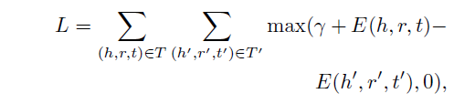

Methodology
Objective Formalization
We utilize a margin-based score function as our training objective, which is defined as follows:
negative sample set:

Slide 13
04
Experiments

Slide 14
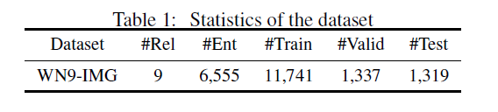
Experiments
Dataset
A new dataset of knowledge graph combined with images named WN9-IMG

Slide 15
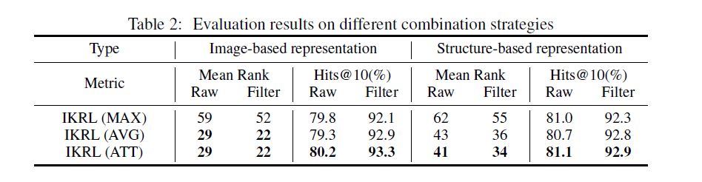
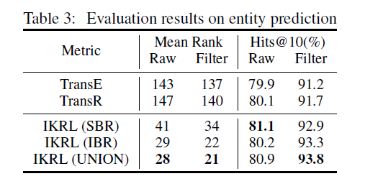
Methodology
Entity Prediction

Slide 16
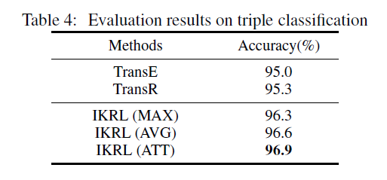
Methodology
Triple Classification

Slide 17
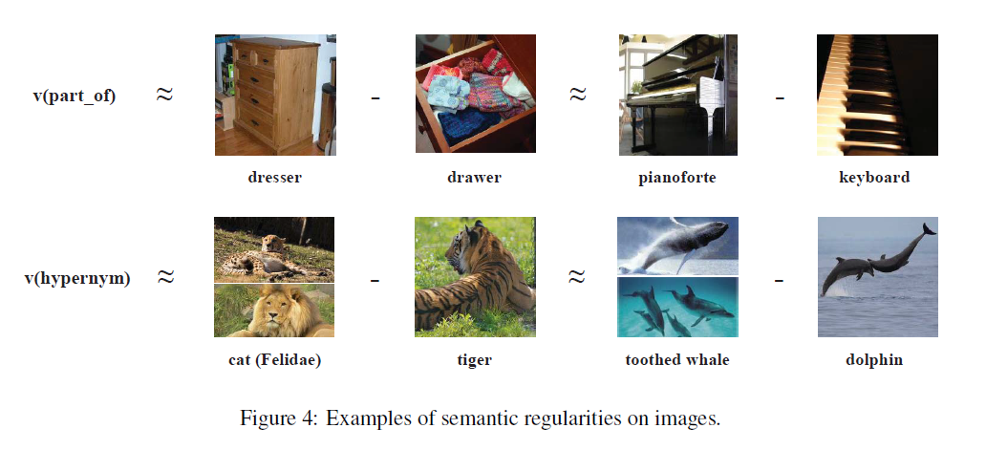
Methodology
Case study-----Semantic Regularities of Images

Slide 18
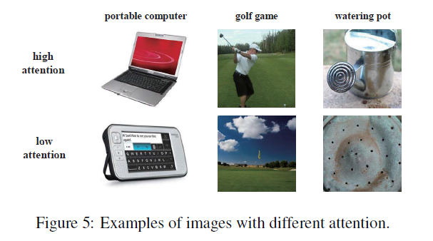
Methodology
Case study-----Capability of Attention

Slide 19
05
Conclusion and Future Work

Slide 20
Conclusion and Future Work
The quality of image representations is essential. We will utilize more sophisticated models to extract better image features in some specific domains.
The current IKRL models are based on TransE. We will explore the effectiveness of our models when extended to other enhanced translation-based methods.
In this paper, we only consider each entity image as the visual representation of its target entity, while sometimes an image contains far beyond a simple entity. We will explore to learn multiple entities and their relations within one image combined with our IKRL models.

Slide 21
PPT模板下载：www.1ppt.com/moban/ 行业PPT模板：www.1ppt.com/hangye/
节日PPT模板：www.1ppt.com/jieri/ PPT素材下载：www.1ppt.com/sucai/
PPT背景图片：www.1ppt.com/beijing/ PPT图表下载：www.1ppt.com/tubiao/
优秀PPT下载：www.1ppt.com/xiazai/ PPT教程： www.1ppt.com/powerpoint/
Word教程： www.1ppt.com/word/ Excel教程：www.1ppt.com/excel/
资料下载：www.1ppt.com/ziliao/ PPT课件下载：www.1ppt.com/kejian/
范文下载：www.1ppt.com/fanwen/ 试卷下载：www.1ppt.com/shiti/
教案下载：www.1ppt.com/jiaoan/ PPT论坛：www.1ppt.cn
谢谢聆听

